Slide 1
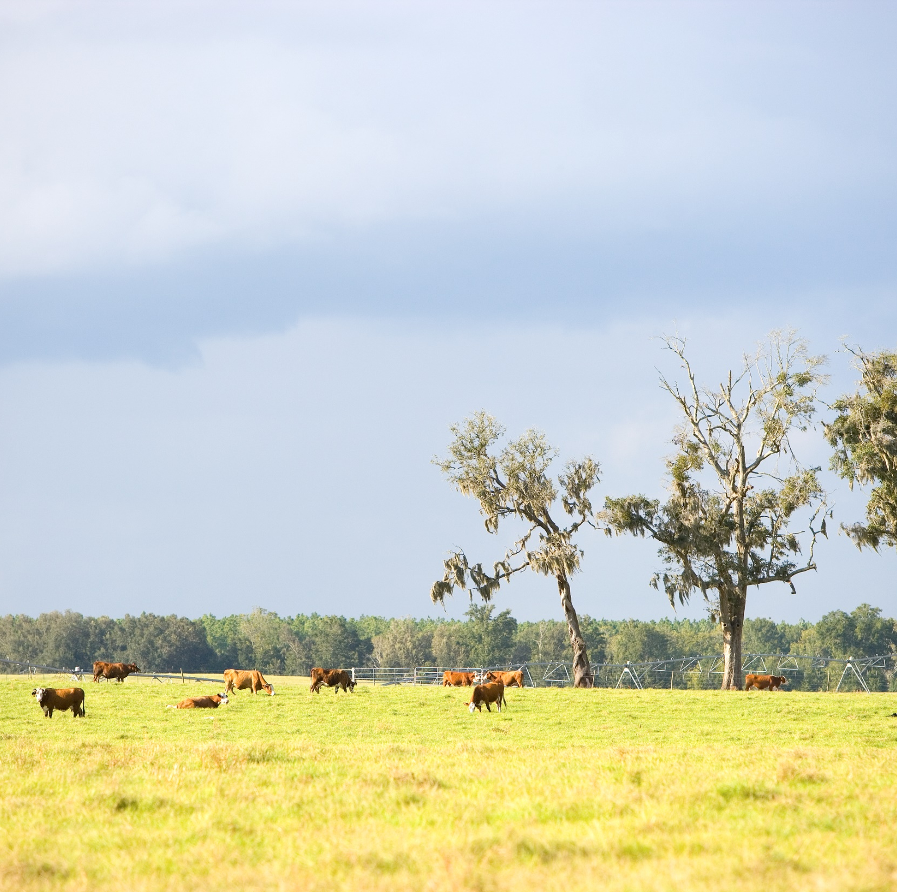
Natural Resources Conservation Service(USDA)
Agricultural Conservation Easement Program
Agricultural Land Easements (ALE)
Florida ACEP Partner Workshop
Photos Credits: USDA NRCS

Slide 2
Agricultural Land Easements
Component of the Agricultural Conservation Easement Program (ACEP)
Purpose: protect the long-term viability of the nation’s food supply by preventing conversion of productive working lands to non-agricultural uses.
Other benefits include historic preservation, wildlife habitat and protection of open space
The conveyance of an Agricultural Land Easement (ALE) prevents the conversion of prime agricultural land to non-agriculture uses.
Three types of ALE deeds:
  General ALE ex. Cropland
  General ALE-Grassland ---Grasslands of Special Significance (GSS)

Slide 3
Program Administration
NRCS provides matching funds to eligible entities for the purchase of perpetual agricultural easements.
Eligible Entities
  State, Tribal, or local governments or non-governmental organizations
  Additional entity eligibility requirements
  Entity submits application for funding with a copy of pending offer to landowner
  Entity is easement holder; NRCS has right of enforcement
Notes:
-demonstrated commitment to conservation of ag lands
-have the ability to acquire, hold, manage and enforce CE
-secure title searches and insurance, complete baseline report, appraisal, survey
-have sufficient funds available for easement acquisition

Slide 4


ALE Landowner Eligibility
Basic eligibility requirements are the same as with other NRCS programs. NRCS partners with Farm Service Agency(FSA) to determine and record landowner eligibility.
  Adjusted Gross Income- AGI waiver available for projects of special significance.
  Highly Erodible Land/Wetland Conservation (HEL/WC)
  Submit to FSA a copy of current CCC-902. Must have Status of Determined.
  State Sun-biz Corporation must be in an active status.
  Title Search, Article of in Corporation, by laws, Signature Authority.

Slide 5
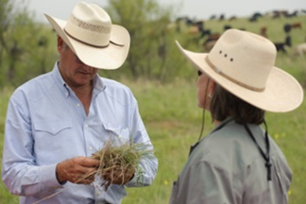
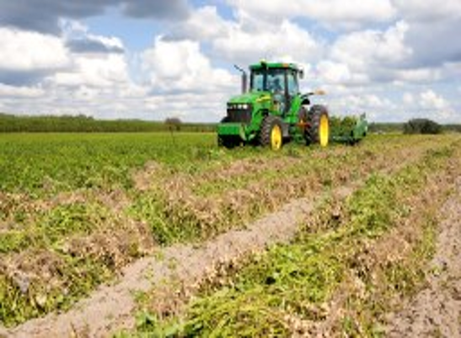
ALE Landowner Process
Step 1: Landowner contacts a land trust
Step 2: Landowner and land trust come to an agreement
Step 3: Land trust applies for ALE funding
Step 4: Application is ranked
Step 5: NRCS review
Step 6: Funds are sent to title company

Slide 6
Matching Funds Requirements
ALE-General-Federal contribution will not exceed 50% of fair market value (FMV)
ALE Grasslands of Special Significance-NRCS may authorize a waiver to increase the Federal contribution to 75% of FMV
For each parcel, the non-Federal share provided by the eligible entity may be comprised of—
(i) The eligible entity’s own cash resources for payment of easement compensation to the landowner.
(ii) A landowner donation toward the easement value in the form of a charitable donation or qualified conservation contribution
(iii) The procured costs paid by the eligible entity to a third-party for the following items: an appraisal, legal boundary survey of the easement area, full phase-I environmental site, title commitment or report, title insurance, or closing cost.

Slide 7
PROGRAM AGREEMENTS WITH PARCEL CONTRACTS
ACEP-ALE program agreements consist of a two-document structure:
Program agreement (NRCS-CPA-41)- the ACEP-ALE eligible entities sign an agreement describing the ACEP-ALE roles and responsibilities for eligible entity participants and for NRCS. There are no funds obligated in the program agreement. 5 year lifespan.
Parcel contract (NRCS-CPA-41A)- provides the funds for the individual easement between NRCS and the entities involved in the acquisition of the individual parcel. The parcel contract details the funding and cost-share for the ACEP-ALE easement.
Notes:
Secures funds for the purchase of the ALEs

Slide 8
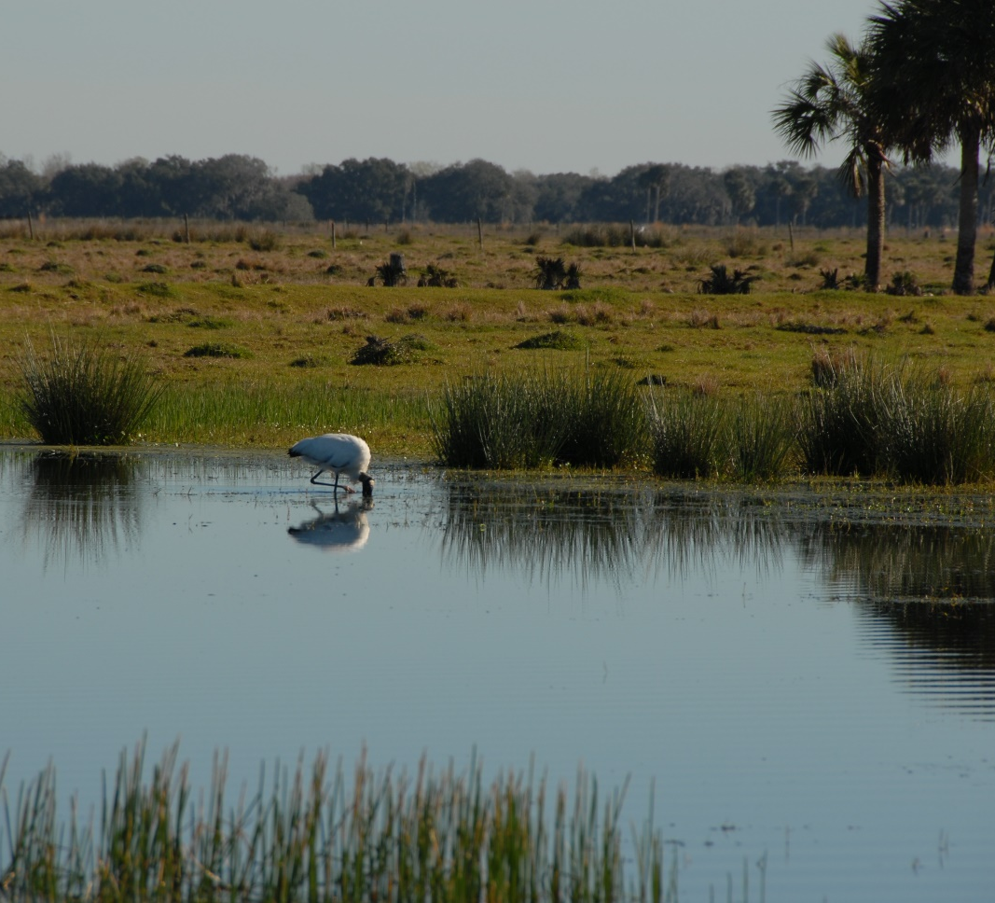
Protecting Florida natural lands.

Slide 9
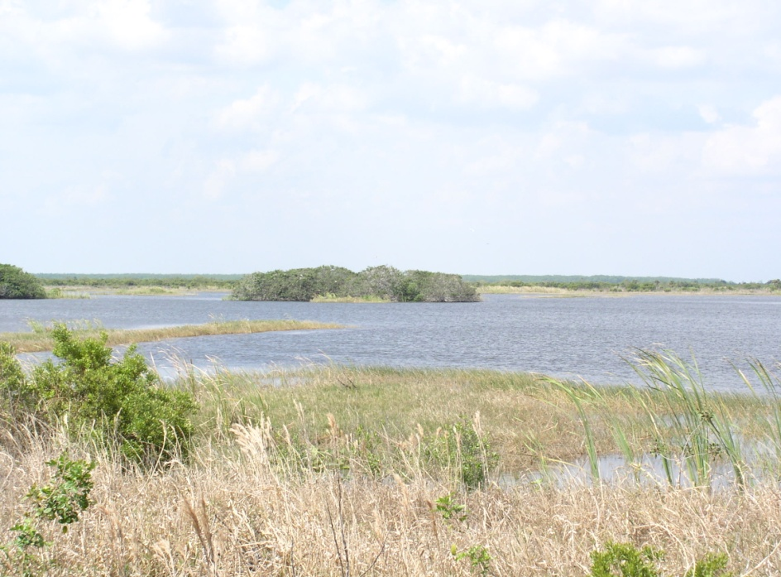
Agricultural Conservation Easement Program-Wetland Reserve Easement (ACEP-WRE)
Application PROCESS

Slide 10
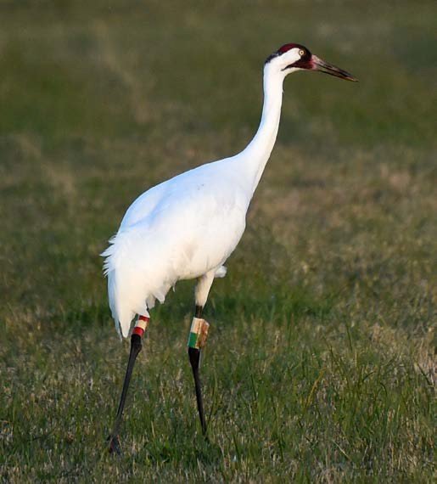
Land Eligibility
Land eligible for wetland reserve easements must be privately owned or acreage owned by Indian Tribes and includes farmed or converted wetlands that can be successfully and cost- effectively restored. NRCS will prioritize applications based on the easement’s restoration, potential for protecting and enhancing habitat for migratory birds and other wildlife.

Slide 11
LANDOWNER ENROLLMENT Options
Enrollment Option Duration Eligible Applicant
30-Year Easement ----30 years or the maximum duration allowed by State law if less than perpetual --- Private landowners or Indian Tribes (including Native Corporations)
Permanent Easement ----Perpetuity ----Private landowners or Indian Tribes (including Native Corporations)

Slide 12
wre FY 2027 Area Wide Market Analysis:
FL has proposed 80% market value and a NTE of $10,500 per acres statewide for FY 27.

Slide 13
WRE- Easement Options
Permanent Easements - This is a conservation easement in perpetuity. The easement payment will be the lesser of the fair market value of the land determined by a Uniform Standards of Professional Appraisal Practice (USPAP) appraisal. In addition to paying for the easement, USDA pays 100 percent of the costs of restoring the wetland and any future maintenance.
30-year Easements - This is a conservation easement lasting 30 years. Easement payments are 75 percent of what would be paid for a permanent easement. USDA also pays 75 percent of restoration costs.

Slide 14
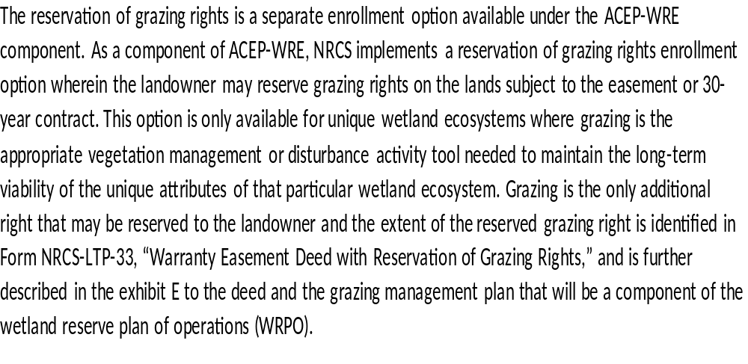
WRE- GRAZING RIGHTS Option

Slide 15
ACEP/WRe Application forms – getting started
FORMS
1. NRCS-CPA -1200 Application
2. Landowner Disclosure Worksheet
3. Haz Landowner Interview
4. Haz Field Inspection
Contact your local USDA/NRCS Field Office

Slide 16
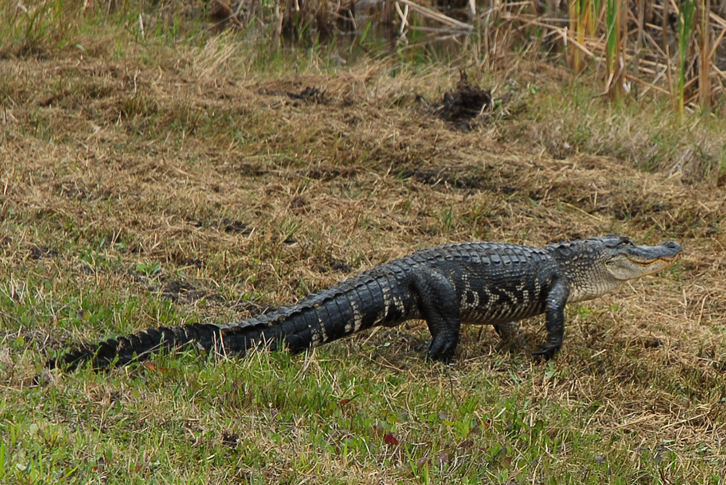
Any Questions?
Thank you.
CRENEL FRANCIS-
ACEP-Easement Coordinator
crenel.francis@usda.gov
Cell 352-538-3937
Office- 352-338-9508

